Slide 1


Basics of Network Network Criteria: Performance, Reliability, Security Type of Connection: Point-to-point, Multipoint Physical Topology: Mesh, Star, Bus, Ring
Lecture # 3 and 4
Week# 2
Data Communications and Networking, Fourth Edition, Behrouz A. Forouzan

Slide 2
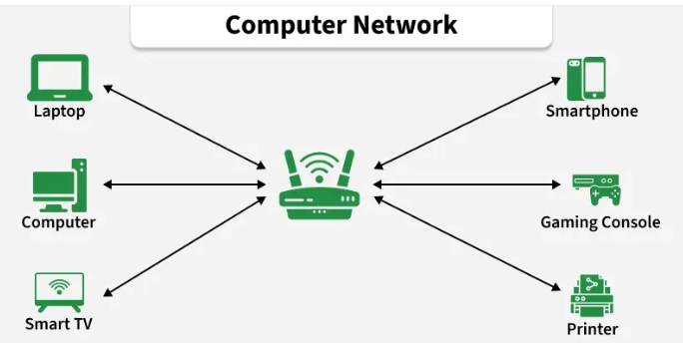
Computer Networks
A computer network is a system of interconnected devices, such as computers, servers, smartphones, and printers, that communicate to exchange data. They communicate using wired or wireless connections and can range from small home networks to the global Internet
Simple Example:
Computers in a school lab connected to one printer
Mobile phones connected to the same Wi-Fi
ATMs connected to bank servers
All these are computer networks

Slide 3
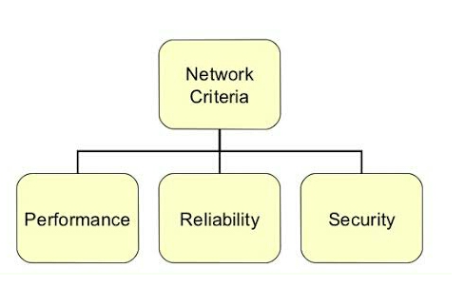
Network Criteria
These are standards used to judge how good a network is
Performance
Meaning: How fast data is sent and received.
Includes:
Speed (bandwidth)
Delay (latency)
Response time
Real-life example: If your online class video loads smoothly without buffering, the network performance is good.

Slide 4
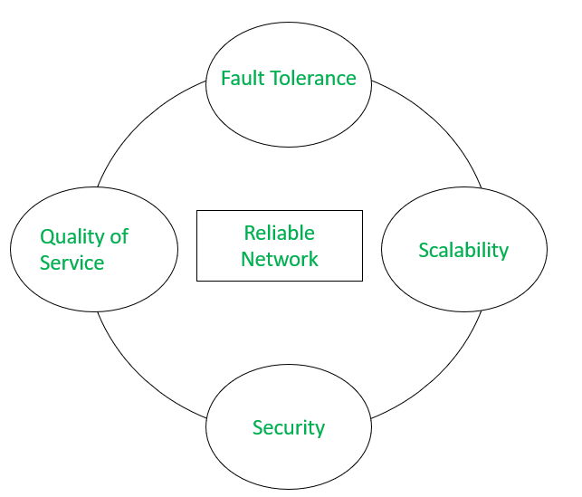
Reliability
Meaning: How dependable the network is (how often it fails).
Includes:
Frequency of failure
Recovery time
Backup links
Real-life example:
University Wi-Fi working all day without
disconnecting = reliable network.

Slide 5
Security
Meaning: Protecting data from unauthorized access.
Includes:
Passwords
Firewalls
Encryption
Real-life example: Only students with login credentials can access LMS portal → security.

Slide 6
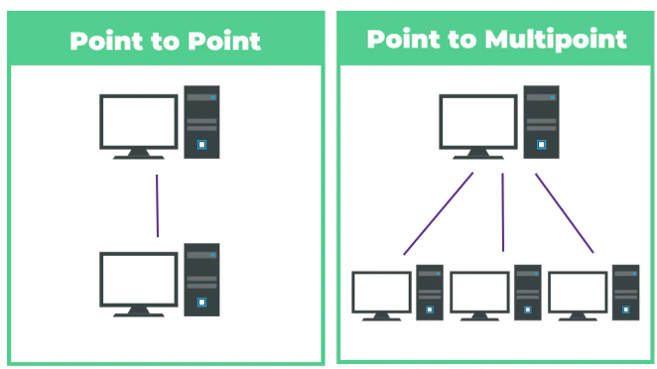
Type of Connection

Slide 7
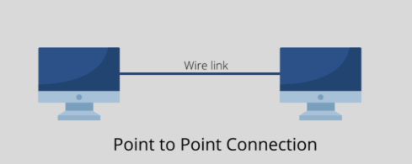
Point-to-Point
Point-to-Point
Meaning: Direct connection between two devices.
Only two devices communicate
Example: Computer connected directly to printer .

Slide 8
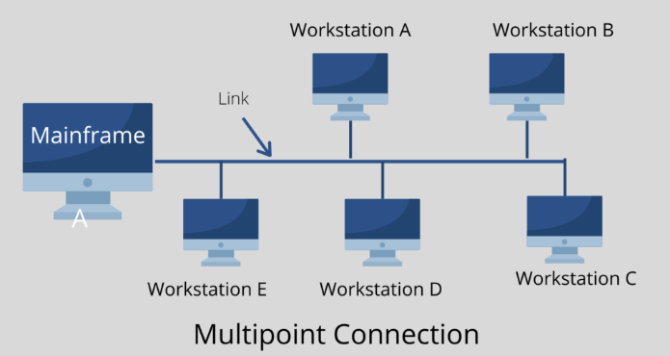
Multipoint
A Multipoint connection is when more than two devices share the same communication link.
Many devices communicate together.
Example:
Many students using one Wi-Fi router
Computers in a lab connected to one switch
Multiple mobiles connected to same hotspot

Slide 9
Network Topology
Network topology is the physical or logical arrangement (layout) of computers and cables in a network.
There are mainly eight types of topology in computer networks:
Mesh Topology
Star Topology
Bus Topology
Ring Topology
Hybrid Topology
P2P Topology
Daisy Chain Topology

Slide 10
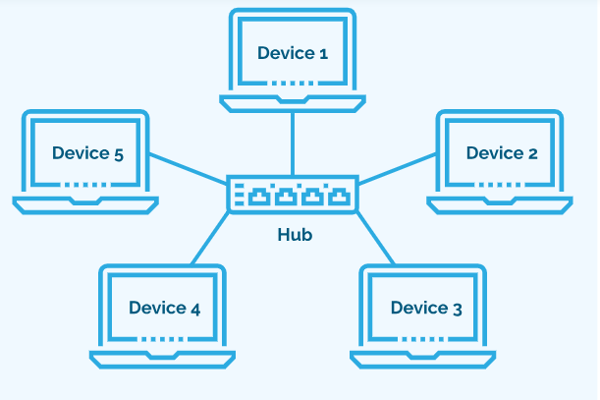
Star Topology
Definition
All devices connect to a central hub or switch.
Real-life Example
Computer labs in schools.
Advantages
Easy to install and manage
One cable failure doesn’t affect others
Easy to add new computers
Disadvantages
If hub fails → entire network stops
Needs more cable

Slide 11
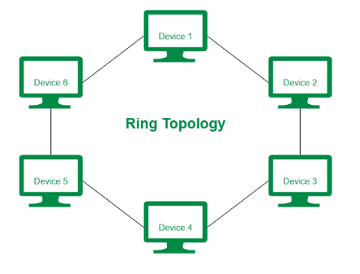
Ring Topology
Definition
Devices are connected in a circular form and data moves in one direction.
Real-life Example
In some cities, the internet company connects buildings in a circle using fiber-optic cable, so the signal goes around the loop until it reaches your home.
Advantages
Equal access for all devices
No data collision
Disadvantages
One device failure affects whole network

Slide 12
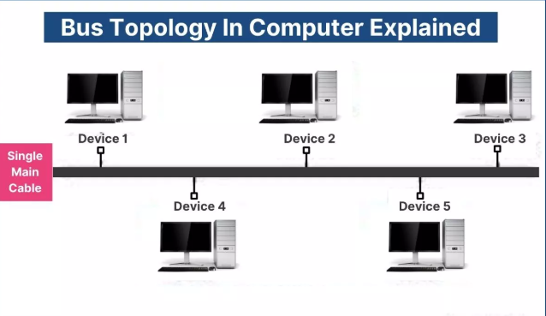
Bus Topology
Definition
All devices share a single main cable (backbone).
Real-life Example
A cable TV line runs along the street, and every house connects to the same main wire. If the main wire is cut, everyone loses the signal
Advantages
Cheap
Simple for small networks
Uses less cable
Disadvantages
If main cable breaks → network fails
Limited number of devices can be connected
Low security

Slide 13
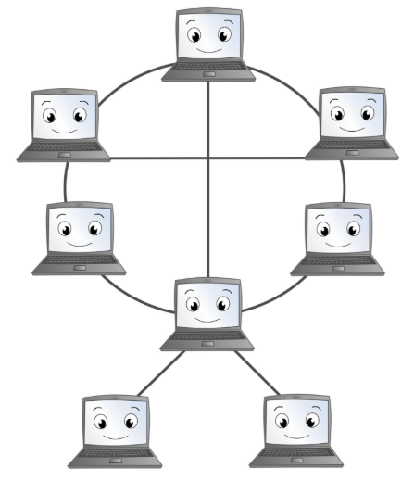
Mash Topology
In Mesh topology, every device is connected to many or all other devices.
Example:
Imagine a bank ATM machine is connected to multiple bank servers/branches:
ATM ↔ Branch A
ATM ↔ Branch B
ATM ↔ Main Bank Server
Now:
If Branch A is unavailable or busy → The ATM automatically sends the request to Branch B or the main server → You can still withdraw money
Advantages
Very reliable (no single point of failure) Fast communication Data can take alternate path
Disadvantages
Very expensive Complex setup

Slide 14
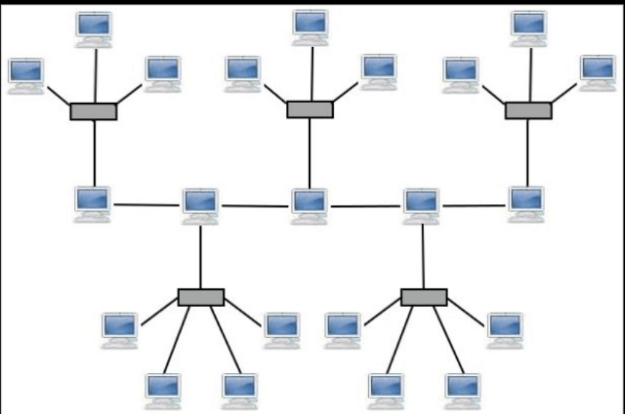
Hybrid Topology
Definition
Hybrid topology is a combination of two or more topologies(Star, Bus, Ring, Mesh).
Real-life Example
In a university network, the computers inside each faculty Rooms are connected in a star topology using a switch.Then all Faculty Rooms are connected to one main cable using bus topology.Together, this forms a hybrid topology.
Advantages
Flexible design
Reliable
Scalable
Disadvantages
Expensive
Complex setup

Slide 15
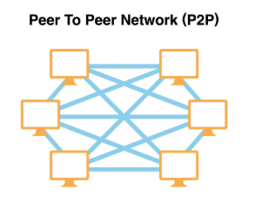
P2P (Peer-to-Peer) Topology
P2P (Peer-to-Peer) Topology
Definition
All computers are equal and share resources directly without central server.
Real-life Example
Two Laptops Sharing Files
You connect two laptops using a LAN cable or Wi-Fi hotspot.
Laptop A sends movie to Laptop B
No router server needed
Both computers directly talk to each other
Advantages
Easy setup
No server needed
Low cost
Disadvantages
Less secure
Not suitable for large networks

Slide 16
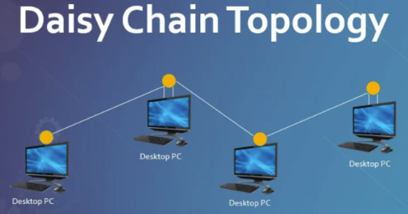
Daisy Chain Topology
Daisy Chain Topology
Definition
Devices are connected one after another in a line.
Example
Printers or monitors connected in series.
Advantages
Simple setup
Uses less cable
Disadvantages
If device fails, others stop
Limited expansion

Slide 17
THANK YOU
You can Find me:
mehakrana.CS@tuf.edu.pk

